Slide 1
Natural Language processing Project
Automatic Text generation using Tensorflow, keras and lstm
Lim Yi Han​
12017694

Slide 2
introduction
In the pursuit of fulfilling the requirements for the successful completion of the NLP course, I have opted for a project offered on Udemy which is Automatic Text Generation using TensorFlow, Keras and Long Short-Term Memory (LSTM). This project involves the exploration of two distinct approaches. The first approach is centered around the application of Long Short-Term Memory (LSTM) standalone, while the second approach integrates LSTM with a Multi-Head Attention mechanism to facilitate text generation.

Slide 3
Problem Statement
The project aims to address the challenge of generating coherent and contextually relevant text in the field of natural language processing. This problem is motivated by the need for more advanced and sophisticated text generation techniques that can produce high-quality text across various applications, such as chatbots, content generation, and more. Specifically, the project seeks to investigate the effectiveness of two distinct approaches: one relying solely on Long Short-Term Memory (LSTM) and the other incorporating LSTM with a Multi-Head Attention mechanism. The goal is to gain insights into merits and limitations of each approach and contribute to the development of improved text generation models within the context of NLP.

Slide 4
DaTA Description
The training data for this project is sourced from “The Project Gutenberg eBook of History of the World War”[1]. This eBook provides historical text content related to World War 1.
The dataset comprises textual content in the English language.
The text data is provided in plain text UTF-8 format.
The text data is used as the primary training material for the AI model to learn to generate coherent and contextually relevant text.

Slide 5
Data preprocessing
The raw text data has been preprocessed to remove any irrelevant or extraneous content, such as metadata or licensing information.
The text data being used as dataset commences at the 737th lines.
A cleaning function is defined and applied to remove the punctuations and non-alphanumeric special characters, followed by converting of the remaining text into lowercase letters.
These lowercase letters are then stored in an array for further use in the project.

Slide 6
Tokenization
Tokenizer imported from TensorFlow Keras is used for tokenization to split the paragraphs and sentences into smaller units that can be more easily assigned meaning.
The preprocessed lines are fed into the which converts the sequence of words into integers using word embedding. This transformation is necessary because machine learning algorithms typically operate on numerical data. Consequently, each unique word is mapped to a corresponding integer.
The lines are converted into a sequences array which have a list of integer values.
The resulting lines are organized into a sequences array, which is essentially a list of these integer values. This sequences array is then converted into a NumPy array.
The two-dimensional array is subsequently split into two parts: X and Y. X serves as the input variable, encompassing the first 50 tokens, while Y represents the output, signifying the last token in the array.
These X and Y datasets are designated for use as training data for the machine learning model in later stages of the project.

Slide 7
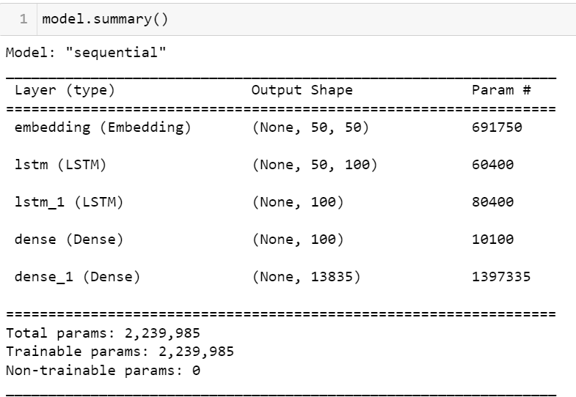
Model Architecture
FIRST Model: LSTM only
The model architecture consists of an Embedding layer that transforms words into numerical representations, two Long Short-Term Memory (LSTM) layers for capturing sequential dependencies, and two Dense layers to learn complex patterns. The initial Dense layer, with ReLU activation, learns intricate data patterns, while the final Dense layer, with softmax activation, generates a probability distribution over the vocabulary, enabling the model to predict the next word in the text generation process.

Slide 8
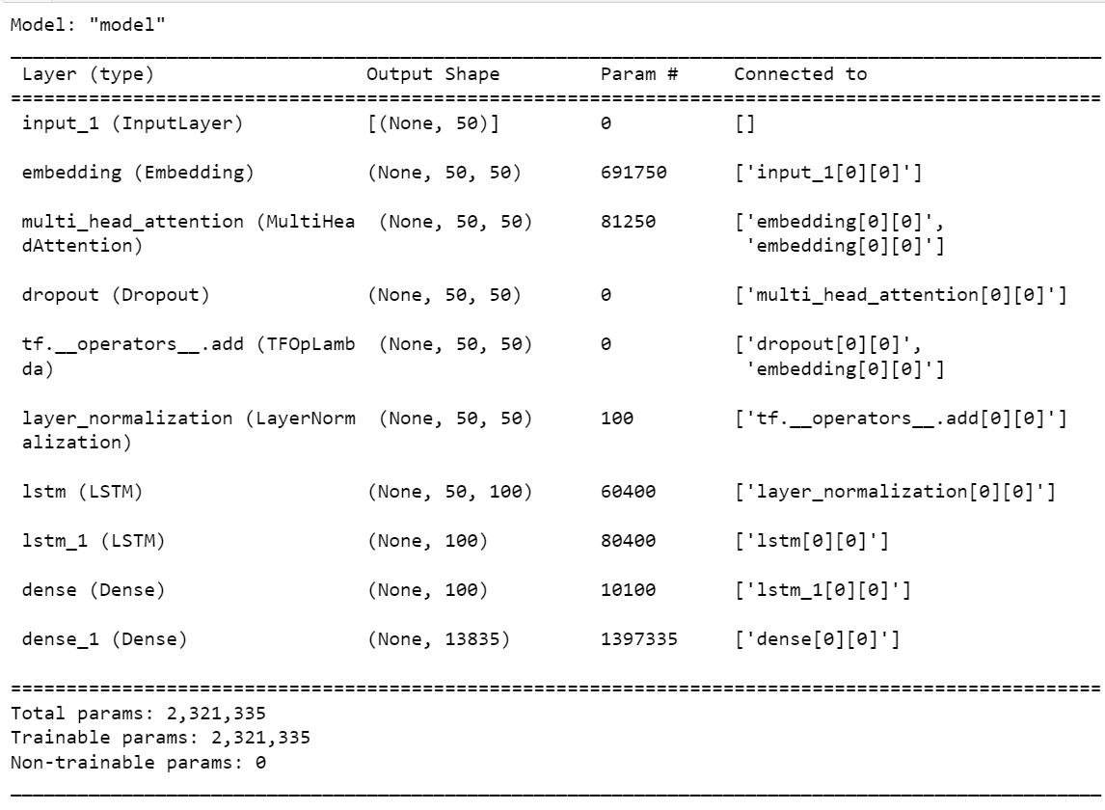
Model Architecture
SECOND Model: LSTM + Multi-Head Attention
This model design encompasses several key components: an Embedding layer to transform input sequences into 50-dimensional vectors, followed by a Multi-Head Attention layer for capturing contextual information and dependencies. Dropout and Layer Normalization are applied for regularization and stability. Two LSTM layers further process the data, and two Dense layers, with ReLU activation in the first, and softmax activation in the second, produce a probability distribution over the vocabulary.

Slide 9
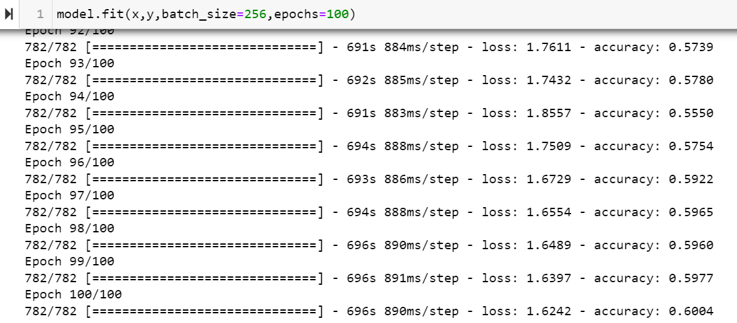
Result
Models | Accuracy in Training
LSTM | 0.4887
LSTM + Multi-Head Attention | 0.6004
LSTM + Multi-Head Attention architecture has higher accuracy of 19% than LSTM standalone due to its ability to comprehensively capture contextual information and dependencies within the text. This combination excels in understanding both global and local patterns. Moreover, it mitigates issues like the vanishing gradient problem associated with LSTM by allowing parallelization.

Slide 10
Result
Models | Seed Text 'the language in which the ultimatum was couched was humiliating to serbia the answer was duly delivered within the stipulated time the demands of the austrian note in brief were as follows the serbian government to give formal assurance of its condemnation of serb propaganda against austria the next issue of'
 | Text Generated
LSTM | the war the majority of the turkish conscription had grown
LSTM + Multi-Head Attention | the police are demanding that he had left the germans

Slide 11
Result
Models | Seed Text 'The german initiated the war because they are
 | Text Generated
LSTM | talking to drive and in the neighborhood of plava the
LSTM + Multi-Head Attention | cool visible indignation and italy was not the gradual allied
According to the results, both models are able to generates grammatically correct sentences. However, the LSTM + Multi-Head Attention model outperforms the standalone LSTM model in producing more contextually relevant and coherent text when combined with seed text. This superiority can be attributed to the Multi-Head Attention mechanism's capability to capture and consider contextual relationships among words, making it more adapt at integrating and extending the context provided by the seed text. The LSTM + Multi-Head Attention model's proficiency in understanding both local and global patterns in the text contributes to generating sentences that align better with the provided context, resulting in text that makes more sense and maintains logical continuity.

Slide 12
summary
In this project, two distinct approaches using recurrent neural networks are explored for automatic text generation. The first approach, employing Long Short-Term Memory (LSTM) exclusively, demonstrated its ability to generate grammatically correct sentences. However, the second approach, which combined LSTM with a Multi-Head Attention mechanism, surpassed the standalone LSTM model in several aspects. Notably, it not only excelled in generating grammatically sound sentences but also produced text that was more contextually relevant and coherent when combined with seed text. This project highlighted the importance of incorporating attention mechanisms in text generation tasks, providing a valuable contribution to the field of NLP. Nonetheless, there remains substantial room for improvement in this field, with the necessity to explore and incorporate more sophisticated architectures like BERT and GPT. These advanced models offer exciting potential for generating even better and more contextually reasonable content. Nevertheless, it's important to underscore that the attention mechanism has unquestionably demonstrated a promising direction for enhancing the quality of text generation, and its continued integration with these cutting-edge architectures represents a fruitful avenue for future research and advancement.

Slide 13
Reference
Beamish, Richard Joseph and March, Francis Andrew. History of World War an authentic narrative of the world’s greatest war. The Project Gutenberg eBook, 2006. https://www.gutenberg.org/cache/epub/18993/pg18993.txt

Slide 14
THANK YOU
yi.han.lim@intel.com

